Slide 1
Bodyfat Analysis
Group 7:Hao Qin, Jiacheng Mao, Qiaoyu Wang, Yuhan Meng

Slide 2
CONTENT:
Data Display
Data Processing
Variable Selection
Model Building
Model Diagnostic
Discussion

Slide 3
DATA DISPLAY

Slide 4
Data Display:

Slide 5
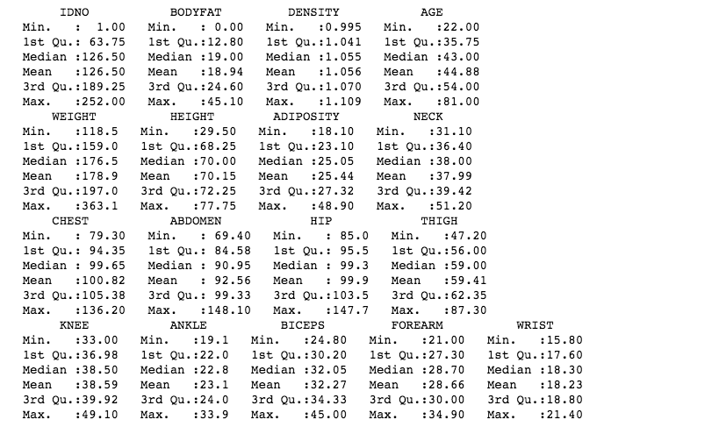
Data Display:

Slide 6
DATA PROCESSING

Slide 7
Data Processing:
1. use “Siri’s equation”
bodyfat = 495/Density - 450
IDNO | BODYFAT | CAL_BODYFAT
48 | 6.4 | 14.14
76 | 18.3 | 14.09
96 | 17.3 | 0.37
182 | 0 | -3.61

Slide 8
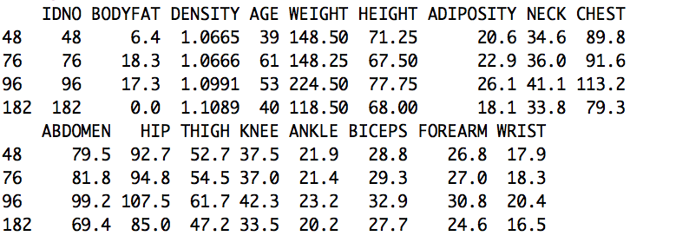
Data Processing:
1. use “Siri’s equation”

Slide 9
Data Processing:
1. use “Siri’s equation”
14.14

Slide 10
Data Processing:
1. use “Siri’s equation”

Slide 11


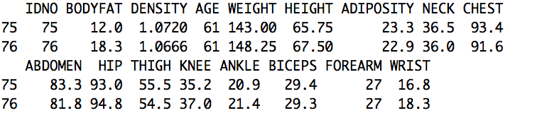
Data Processing:
1. use “Siri’s equation”

Slide 12
Data Processing:
1. use “Siri’s equation”
14.09

Slide 13
Data Processing:
1. use “Siri’s equation”

Slide 14
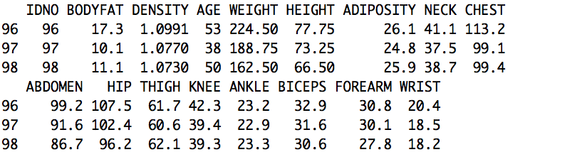
Data Processing:
1. use “Siri’s equation”
If use density →bodyfat : 495/1.0991- 450=0.3684833
If use bodyfat → density :495/(17.3+450) =1.059277

Slide 15
Data Processing:
1. use “Siri’s equation”
If use density →bodyfat : 495/1.0991- 450=0.3684833
If use bodyfat → density :495/(17.3+450) =1.059277

Slide 16
Data Processing:
1. use “Siri’s equation”
Negative!
Both density and bodyfat
are wrong! Delete 182!
If use density →bodyfat : 495/1.1089- 450=-3.611687

Slide 17
Data Processing:
1. use “Siri’s equation”
bodyfat = 495/Density - 450
After changing the values of 48,76,96,
and deleting the observation 182 :
Remember in the data display part
the 216 has a density<1, also delete.

Slide 18
Data Processing:
2. use “BMI equation”
bmi=weight/(height)^2
IDNO | WEIGHT | HEIGHT | ADIPOSITY
42 | 205.00 | 29.50 | 29.9
163 | 184.25 | 68.75 | 24.4
221 | 153.25 | 70.50 | 24.5

Slide 19
Data Processing:
2. use “BMI equation”
bmi=weight/(height)^2
Construct a linear model between BMI and ADIPOSITY, without 42,163,221
IDNO | WEIGHT | HEIGHT | ADIPOSITY
42 | 205.00 | 29.50 | 29.9
163 | 184.25 | 68.75 | 24.4
221 | 153.25 | 70.50 | 24.5

Slide 20
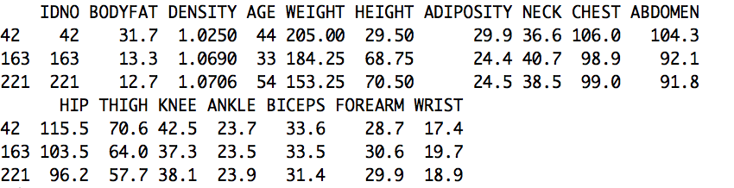
Data Processing:
2. use “BMI equation”
29.5 inches? Impossible!
Hence we use the model we fit to compute the BMI
first and then we can get the height: 69.46.

Slide 21
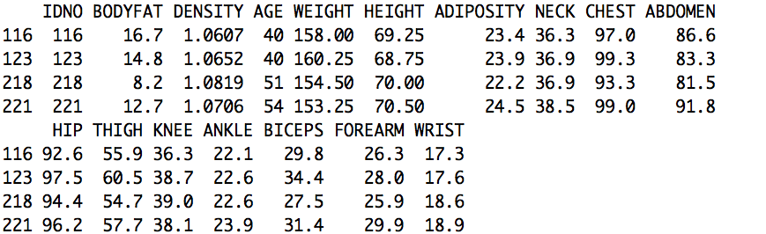
Data Processing:
2. use “BMI equation”
172.9469 lbs
Compare 218&221,similar weight and height but difference ADIPOSITY!
Other variables 221>218, especially the bodyfat !
Hence the ADIPOSITY is right. Also the mean of height is 70.15.

Slide 22
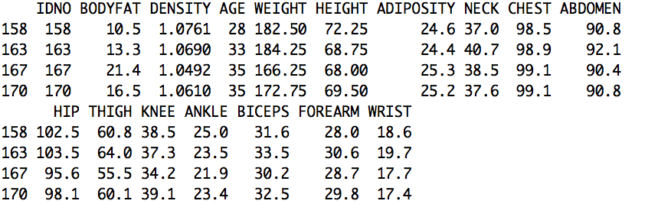
Data Processing:
2. use “BMI equation”
27.42749

Slide 23
Data Processing:
2. use “BMI equation”
bmi=weight/(height)^2
Using these two euqations we only delete 182,216 and change some values.

Slide 24
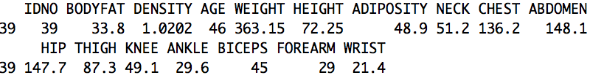
Data Processing:
3. Cook's distance

Slide 25
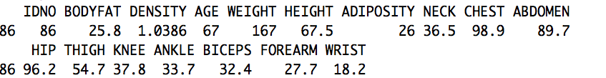
Data Processing:
3. Cook's distance
With values of the rest of the variables are on the average, the value of ankle is too high.

Slide 26
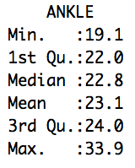
Data Processing:
3. Cook's distance
With values of the rest of the variables are on the average, the value of ankle is too high.

Slide 27
THE NOISE OBSERVATIONS : 39,86,182,216

Slide 28
MULTICOLLINEARITY CHECK

Slide 29
Varable Selection

Slide 30
BeSS(Best Subset Selection) method
Best Subset Selection is based on the generalized model and Cox proportional hazard model and implemented by the primal dual active set algorithm.

Slide 31
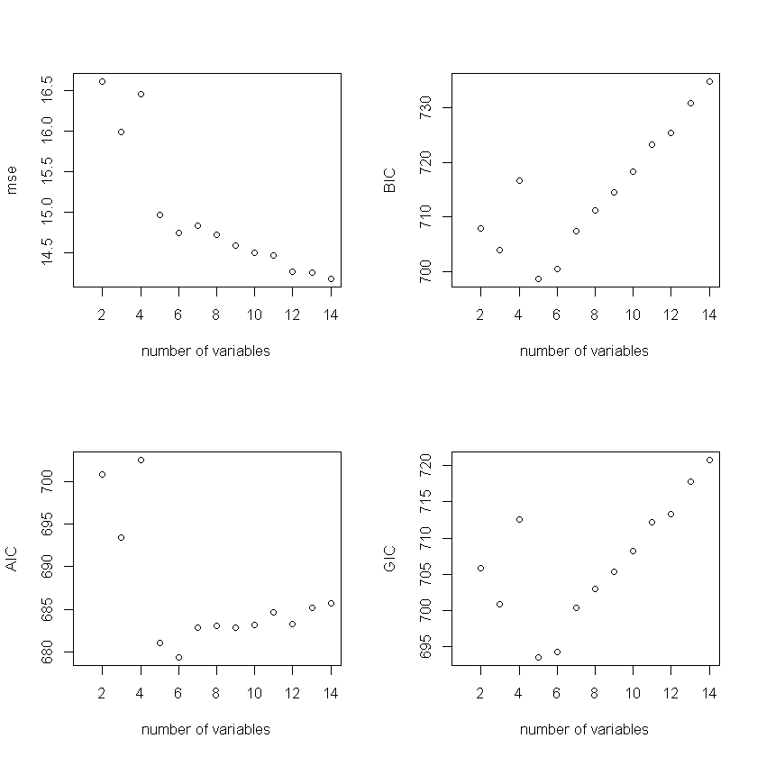
BeSS(Best Subset Selection) method
Calculating the AIC, BIC, GIC and mse using BeSS method, we can compare with different number of variables, the performance of fitted model.
Best variable choices
Mse: 4
AIC: 6
BIC: 5
GIC: 5

Slide 32
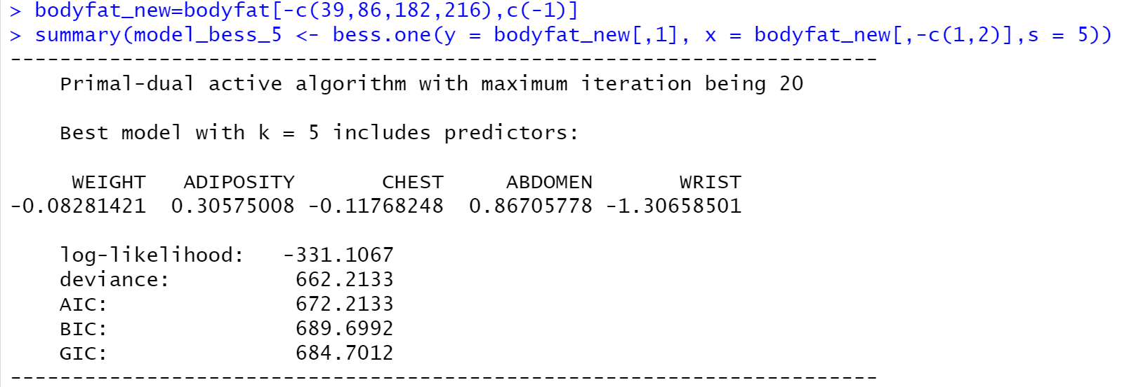
BeSS(Best Subset Selection) method
From the BIC criterion, the best choice is use five variables to fit the model.
Bodyfat ~ WEIGHT + ADIPOSITY + CHEST + ABDOMEN + WRIST

Slide 33
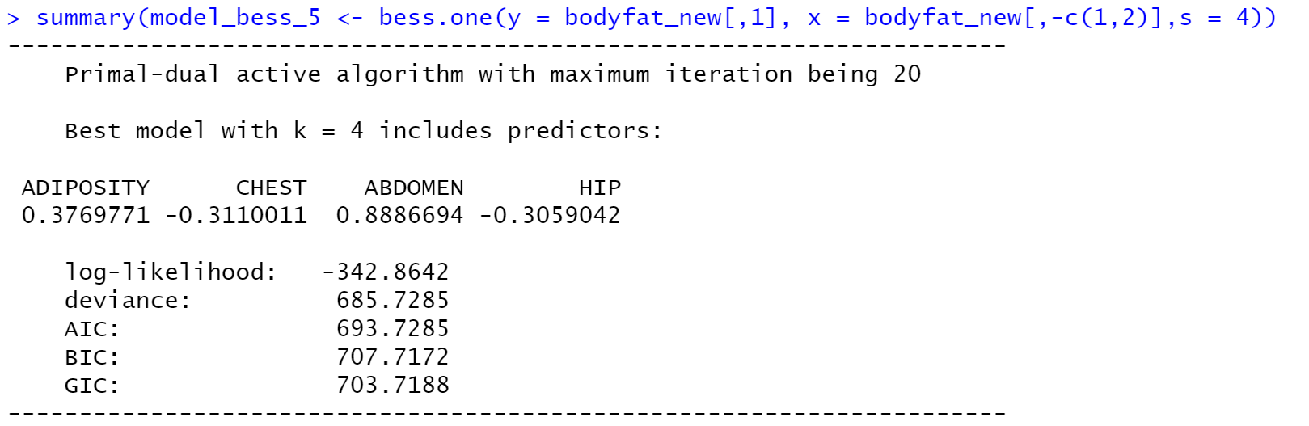
BeSS(Best Subset Selection) method
The optimal choice is five variables, but it is too complicated.
Leave WRIST out

Slide 34
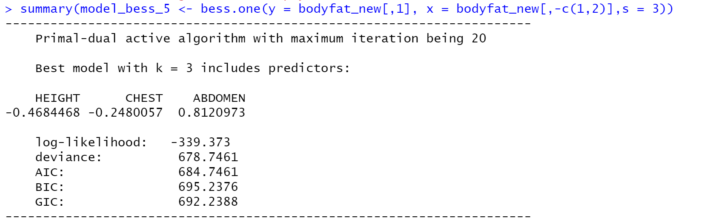
BeSS(Best Subset Selection) method
Try three variables

Slide 35
CONTENT:
Dateset Display
Data Cleaning
Multicollinearity Check
Varable Selection
Model Building
Model Interpretation
Model Summary
Model Diagnostic
Discussion

